Slide 1

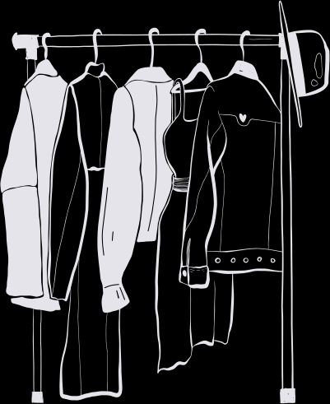


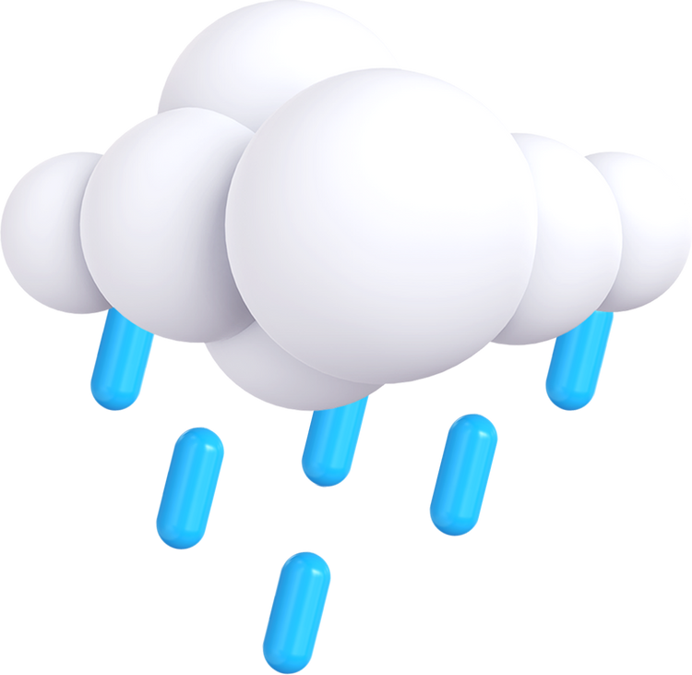


WEATHER WEAR
Presented By Team - 3 Bad Ideas

Slide 2

AGENDA
1
Team Introduction
4
7
Team working agreement
Personas
2
Problem Statement
5
Technologies & Algorithms
8
Retrospective
3
Project Description
6
9
Project Schedule
Wikipage Link

Slide 3
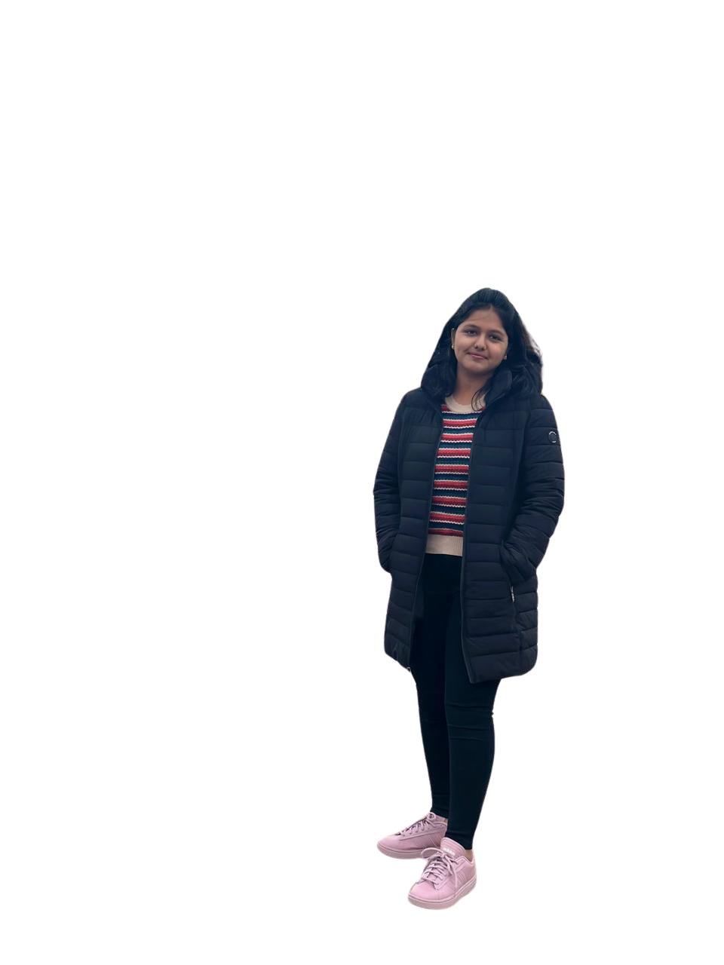
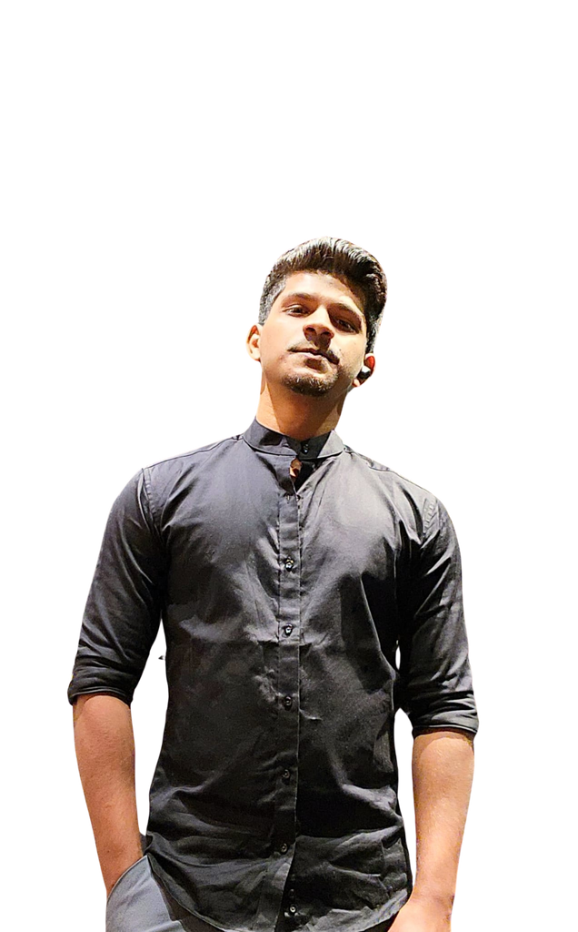
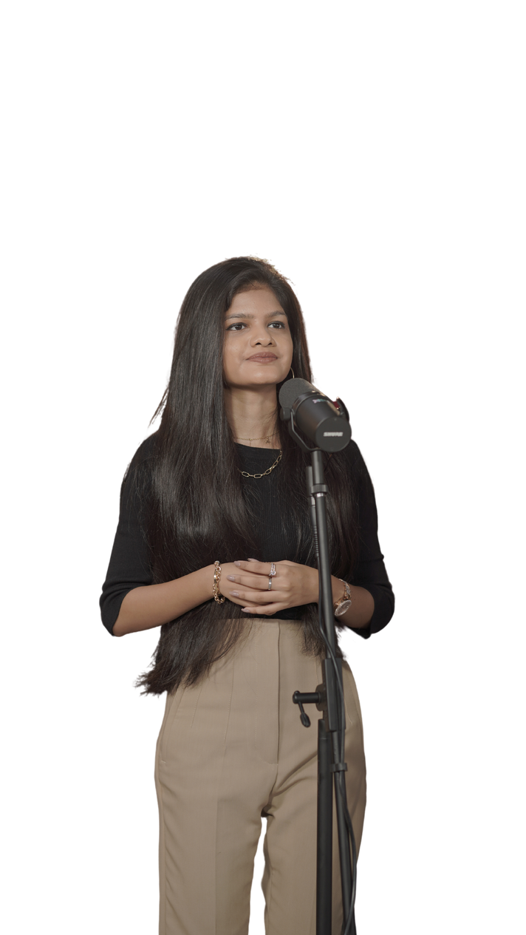
THIS IS OUR TEAM
Helloween James
Gracia Betty Jebaraj Daniel
Tejaswini Kandyala
Project Manager & Machine Learning Engineer
Frontend Developer & UI/UX Designer
Frontend Developer

Slide 4
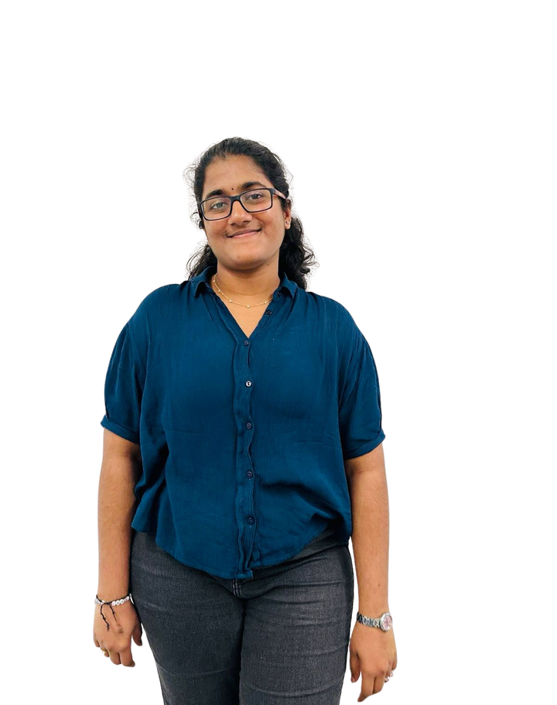
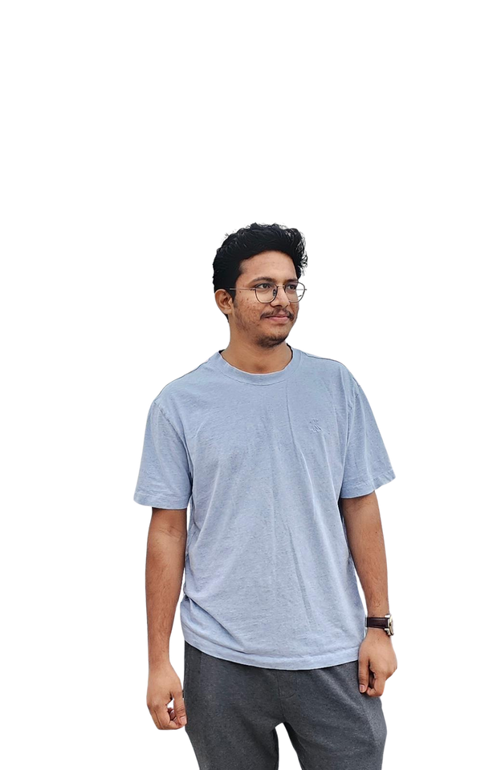
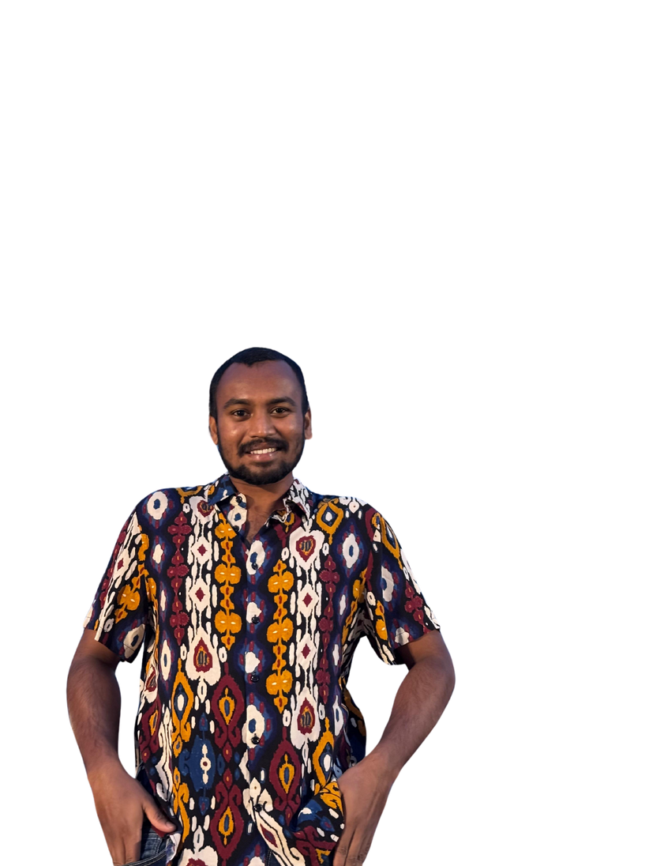
THIS IS OUR TEAM
Bharadwaj Reddy Asireddy
Mohith Durga Srinivas Tripuramallu
Sai Rajeswari Ghanta
Backend Developer & UI/UX Designer
Quality Assurance Tester
Backend Developer

Slide 5
PROBLEM STATEMENT
The weather keeps changing constantly, which makes it unpredictable. This causes difficulties for people in selecting which clothes to wear. It causes inconvenience, discomfort, and even wasted time for people. Since people don’t know how the weather is going to be or can’t predict the weather, they may end up either being underdressed or overdressed.

Slide 6
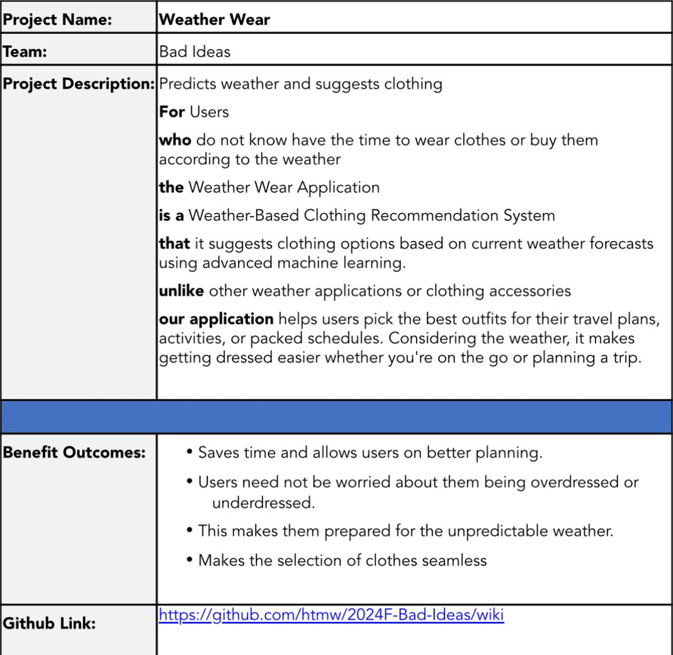
PROJECT DESCRIPTION

Slide 7
PERSONAS

Slide 8
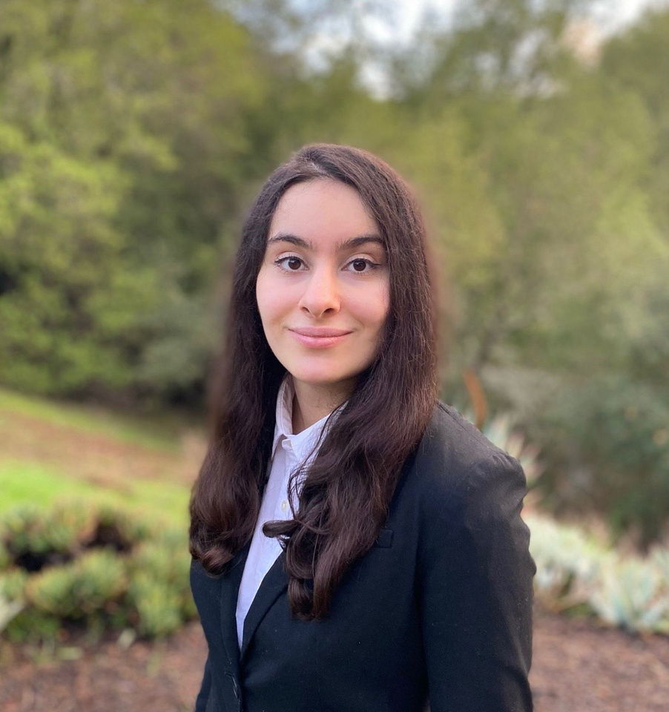
HANNAH
This is Hannah, Age 28. She stays in New York City, NY and she is Product Manager.
Life Style: She commutes everydays and she meets a lot of clients.
Weather and Clothing: NYC weather is totally unpredictable as it can rain, be sunny or be cold anytime. She likes wearing formal clothes.
Technology usage: She loves trying out new apps.
She is busy person and always wears uncomfortable dress which does not align well with weather, so she needs something which can set her to wear clothes which doesn't waste her time.

Slide 9
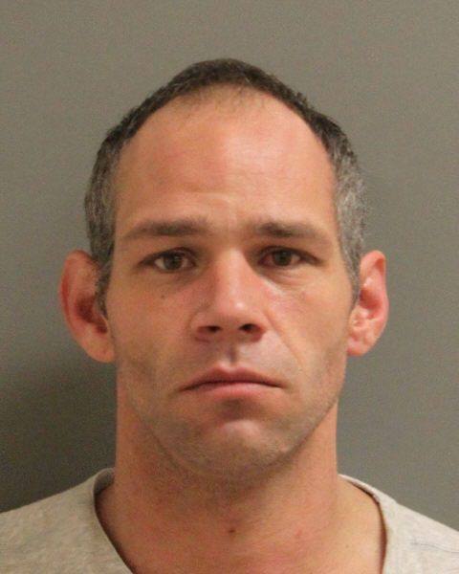
JASON
This is Jason, Age 34. He stays in Seattle, WA, and he is a Software Engineer.
Life Style: He commutes to the office twice a week and enjoys biking when the weather permits.
Weather and Clothing: Seattle's weather is unpredictable, with frequent rain and sudden changes. He prefers casual and comfortable clothing but often finds himself either underdressed for cold weather or overdressed when it warms up unexpectedly.
Technology usage: He is tech-savvy and enjoys trying out new apps to improve efficiency.
He frequently faces issue with choosing the right clothes due to the constant change in weather and he needs a solution that helps him dress appropriately for the day.

Slide 10
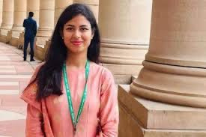
ANANYA
This is Ananya, Age 22. She stays in Mumbai, India, and she is a College Student.
Life Style: She walks around campus a lot, balancing her classes, internships, and extracurricular activities.
Weather and Clothing: Mumbai's weather can be unpredictable, with sudden rain showers or humid heat. She likes trendy, comfortable clothes but struggles to dress appropriately when the weather changes quickly.
Technology usage: She uses multiple apps to manage her busy schedule and lifestyle.
She often finds herself either drenched in rain or overheated due to sudden weather changes and needs something that will help her choose the right outfit for the day without wasting time.

Slide 11
TECHNOLOGIES
Frontend
Backend
Database
Next JS
Shadcn
Tailwind CSS
Flask
Open weather API
MongoDB

Slide 12
TECHNOLOGIES
Deployment
Machine Learning
Tools
Figma
VSCode
Codespaces
Github
Postman
Vercel
AWS
Scikit Learn
Pytorch

Slide 13

ABOUT FRONTEND TECHNOLOGIES
So here next js is used for building the website because next js is one of the best frontend frameworks and with integration with shadcn and tailwind css, building minimalistic website easier.

Slide 14

ABOUT BACKEND TECHNOLOGIES
So flask, one the best lightweight backend library and it can be used for production as well but for minimal tasks and open weather API, which is most important part of this application because it gives the live data about the weather.

Slide 15

ABOUT DATABASE TECHNOLOGIES
MongoDB is one the best NoSQL database and as the application data can also be unstructured, this would be best option to choose it. This also have fast retrieval ( read operations) compared to SQL databases, so this is better choice for this application.

Slide 16

ABOUT DEPLOYMENT TECHNOLOGIES
Here, first vercel is used for deploying the frontend part of the application and aws is used for deploying backend and machine learning as well because NextJS works seamless in vercel, as vercel are the one who developed Next js.

Slide 17

ABOUT MACHINE LEARNING TECHNOLOGIES
So here scikit learning is primarily used for building the basic version of the machine learning algorithms and in later on stages, Pytorch is used for build even more accurate version of the machine learning which understands the weather even more better and predicts it well.

Slide 18

ABOUT TOOLS TECHNOLOGIES
Figma is mainly used for prototyping and design how the product looks like. VSCode is where actually the code is written. Codespaces is where the collaboration code is done, for pair programming. Github is where whole code is hosted. Postman is for testing the API endpoints.

Slide 19
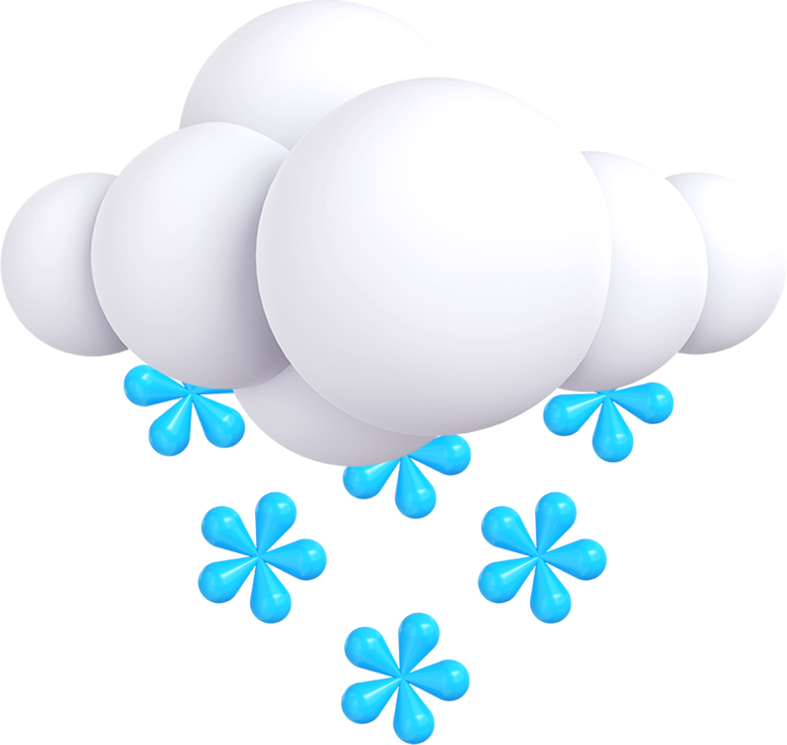
ALGORITHMS
Predicting Weather
Random forest regressor
Used to predict weather conditions like temperature or humidity by learning patterns from historical weather data through decision trees that capture non-linear relationships.
LSTM
A recurrent neural network used to predict future weather by capturing long-term dependencies and patterns in sequential weather data over time.
Recommendation
KNN (k-nearest neighbours)
Used to recommend outfits by finding similar users (or outfits) based on user preferences and weather conditions, suggesting clothing choices that worked for users with similar profiles or conditions.

Slide 20
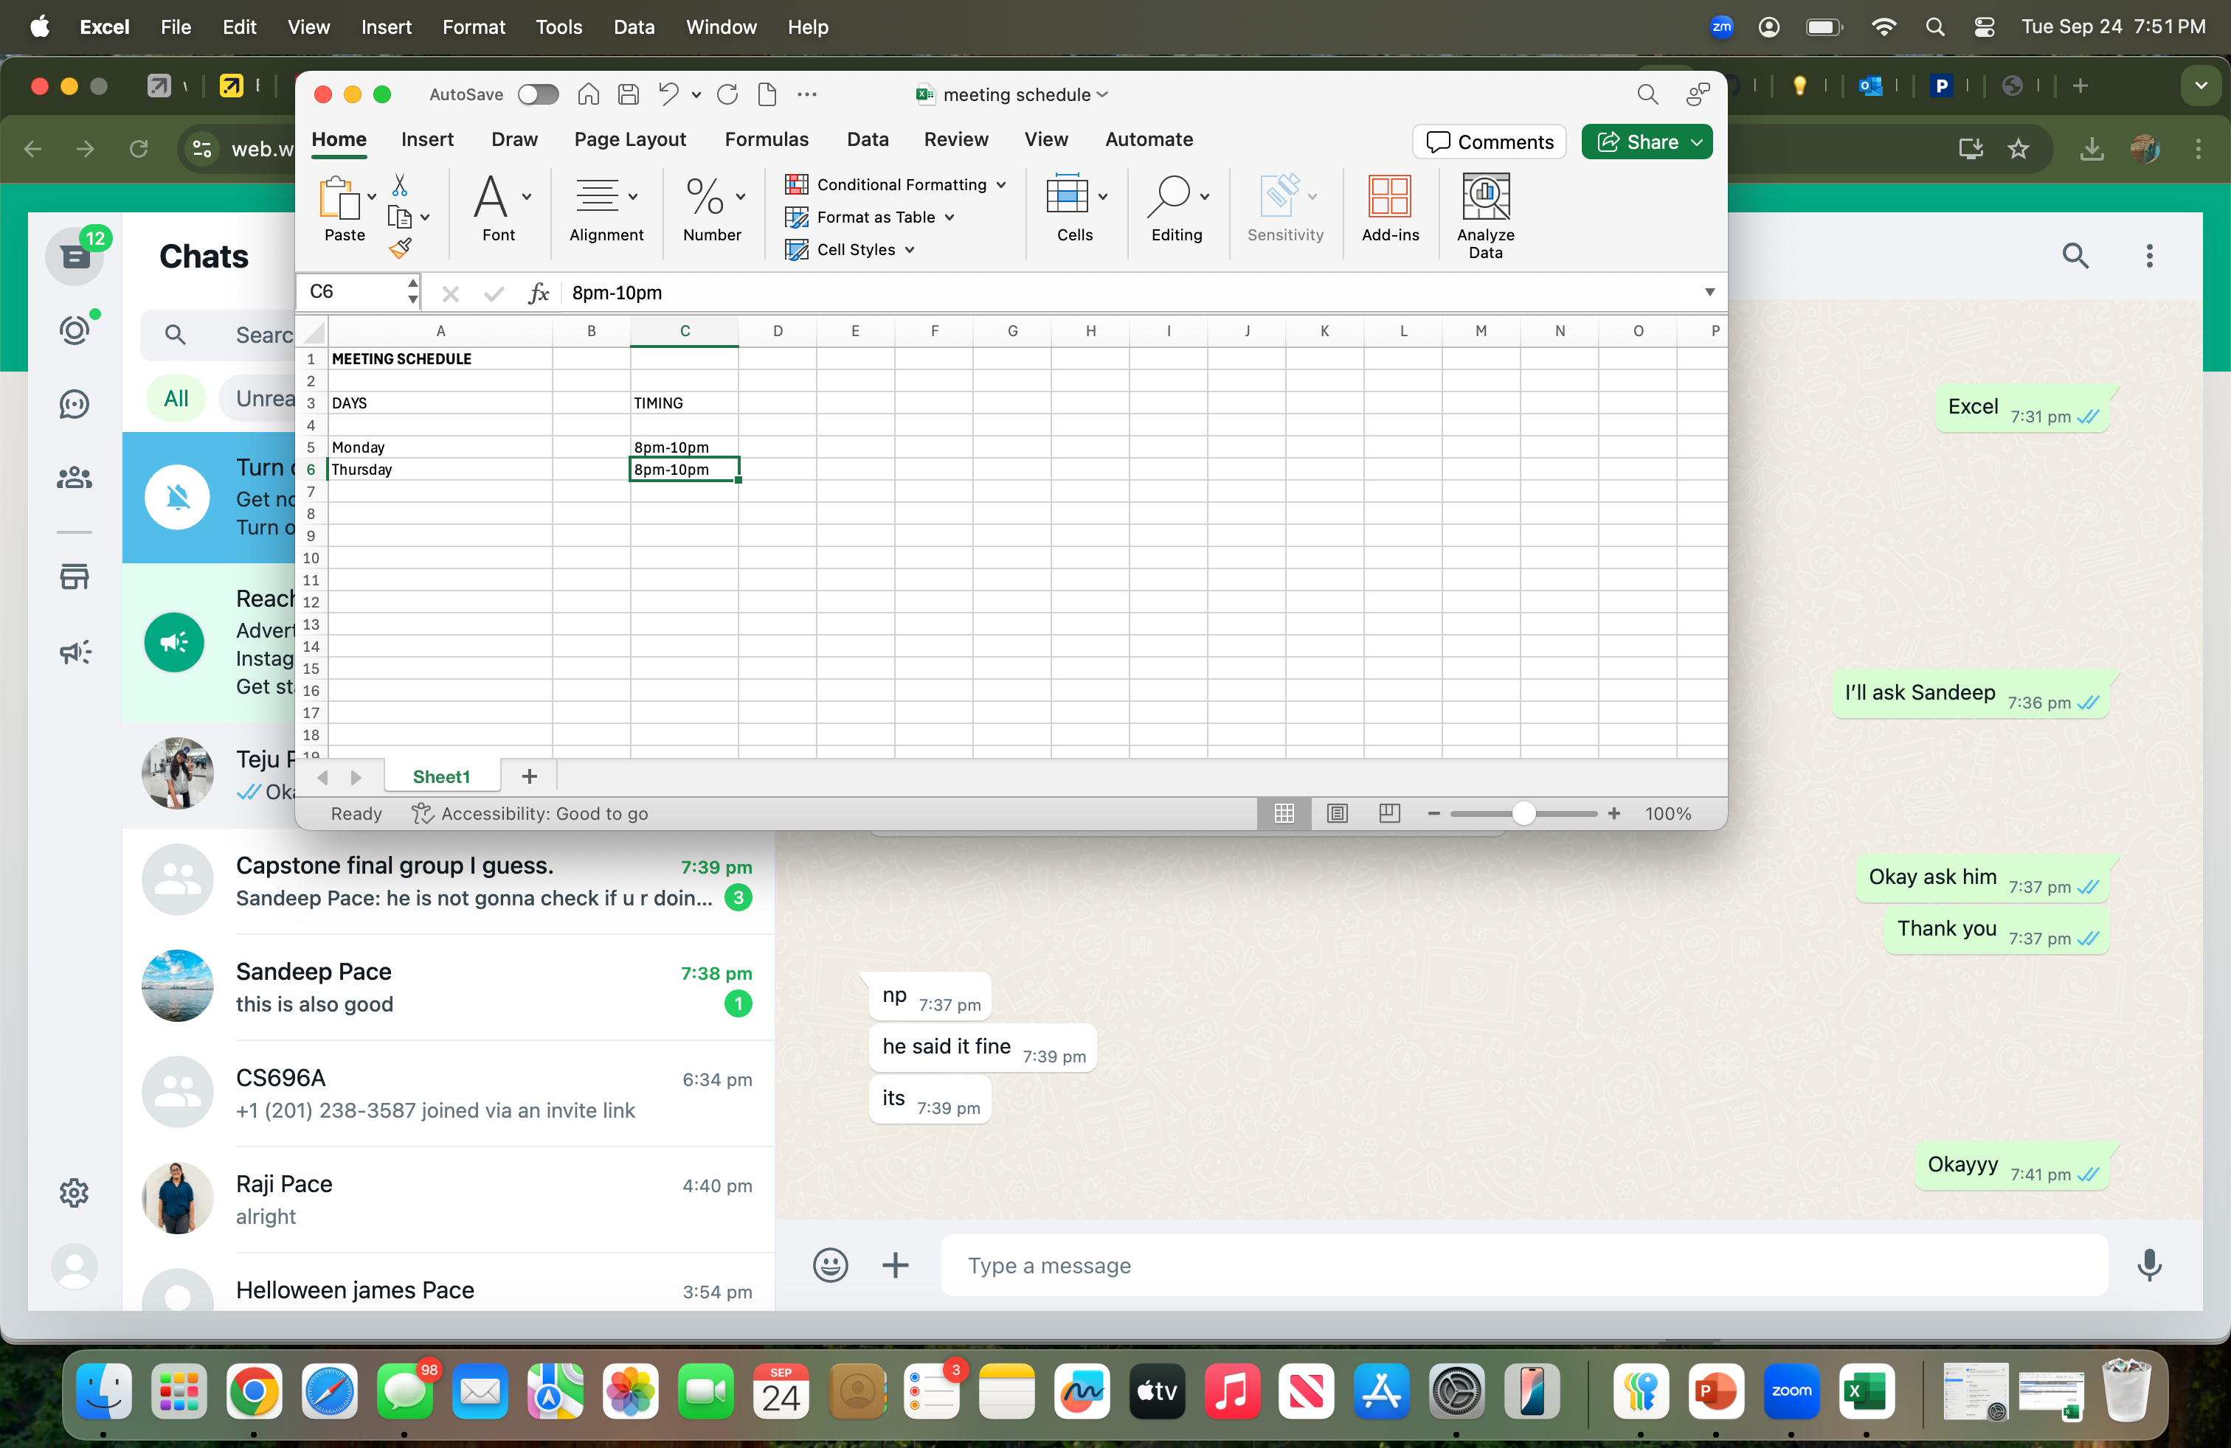
PROJECT SCHEDULE

Slide 21

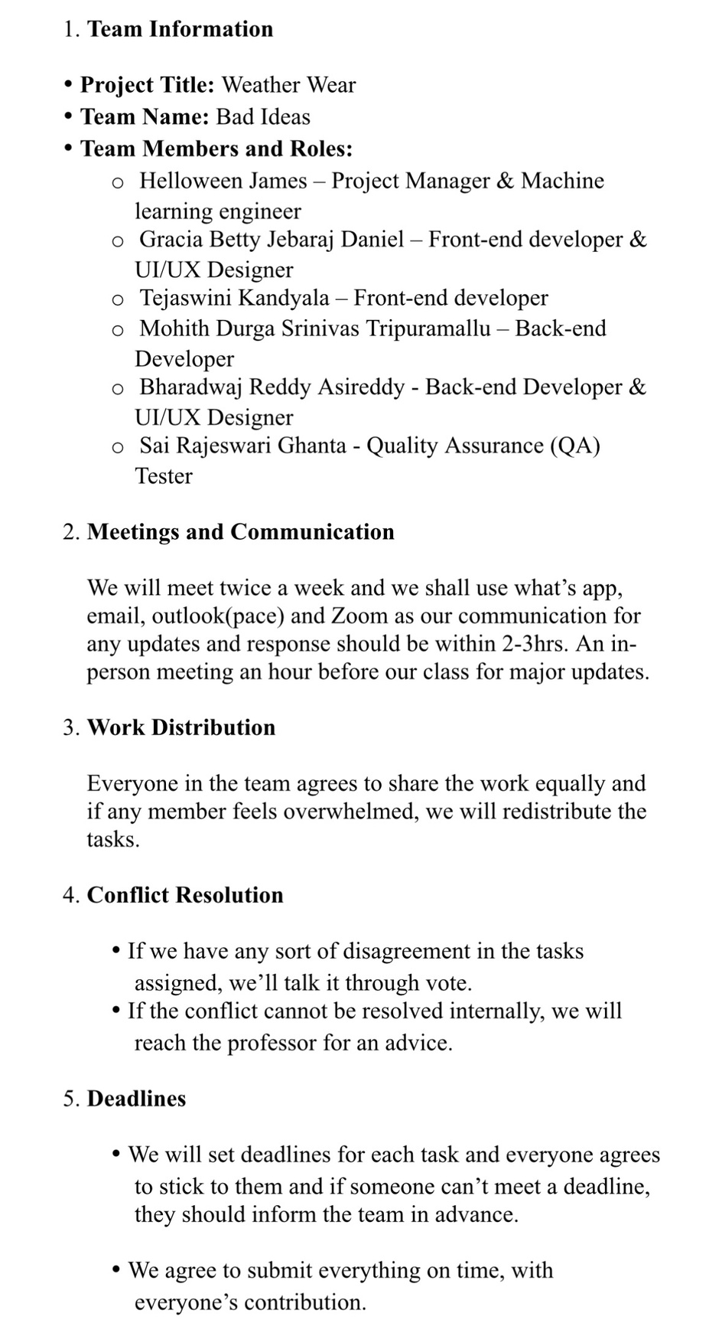
TEAM AGREEMENT

Slide 22
TEAM AGREEMENT

Slide 23
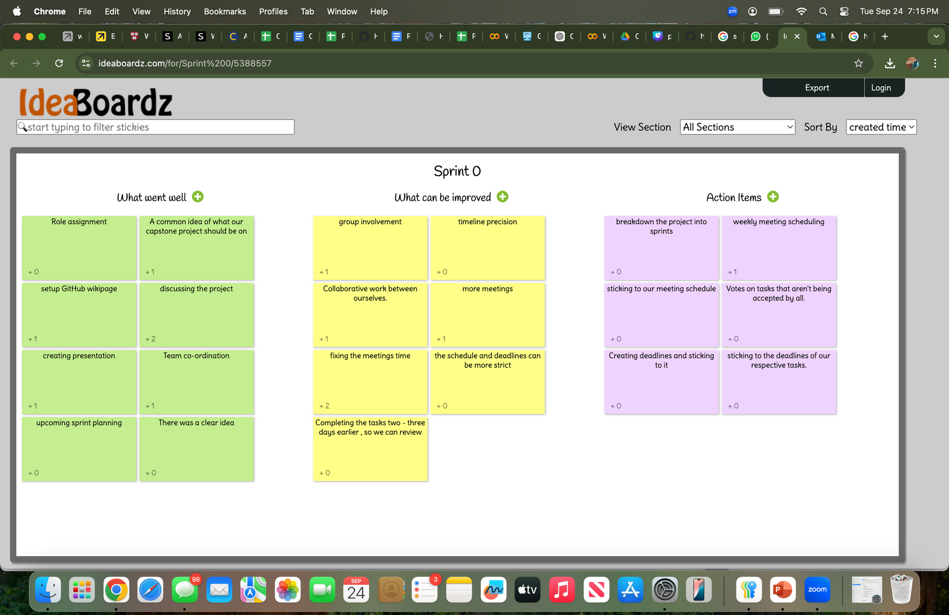
RETROSPECTIVE

Slide 24
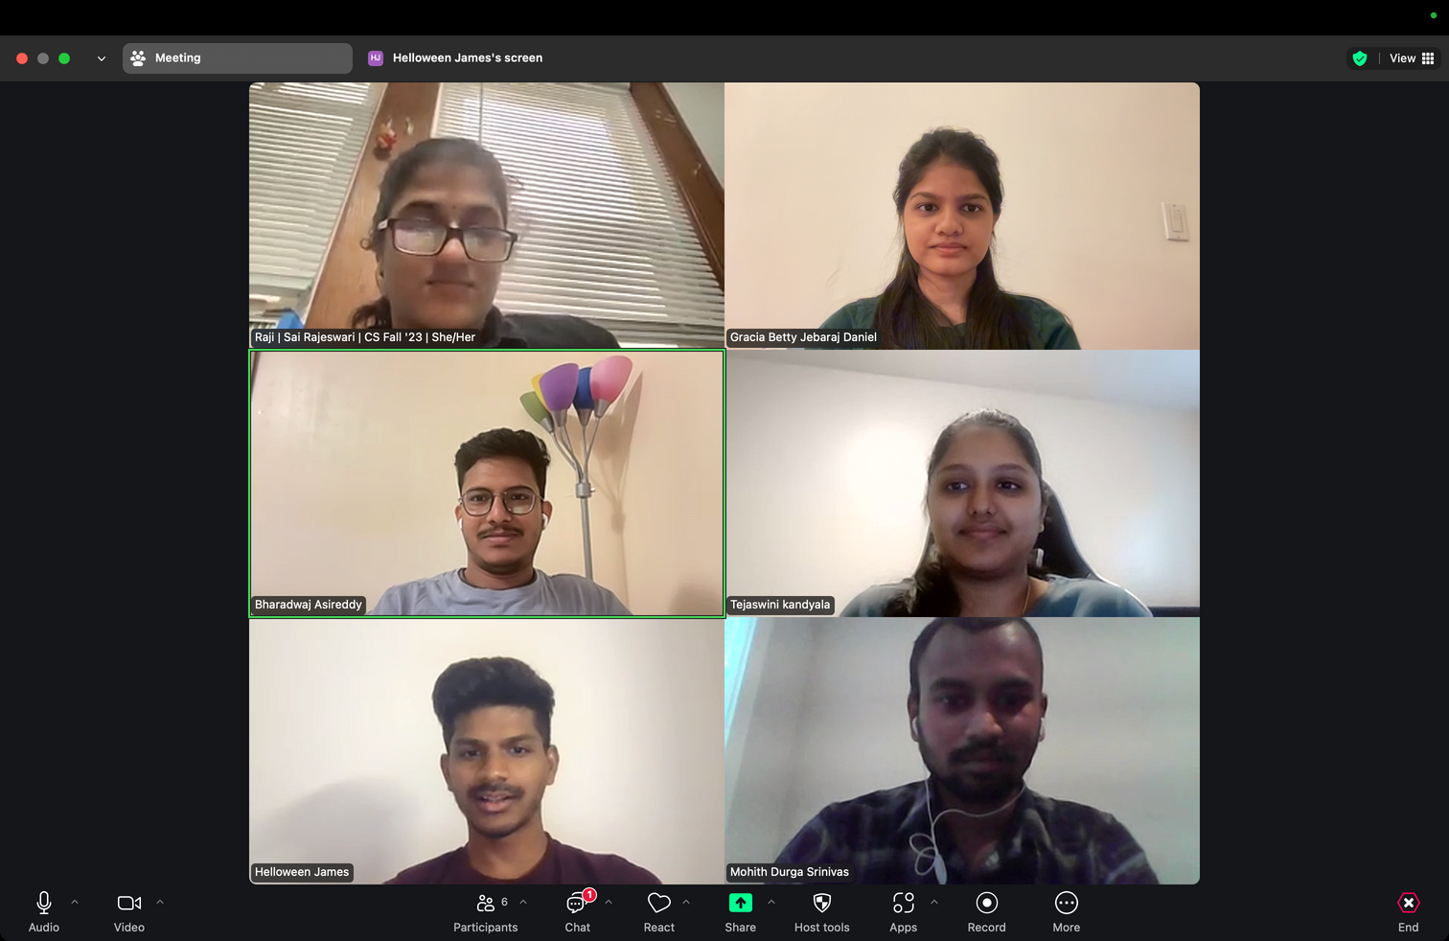
RETROSPECTIVE

Slide 25
WIKIPAGE
https://github.com/htmw/2024F-Bad-Ideas/wiki

Slide 26
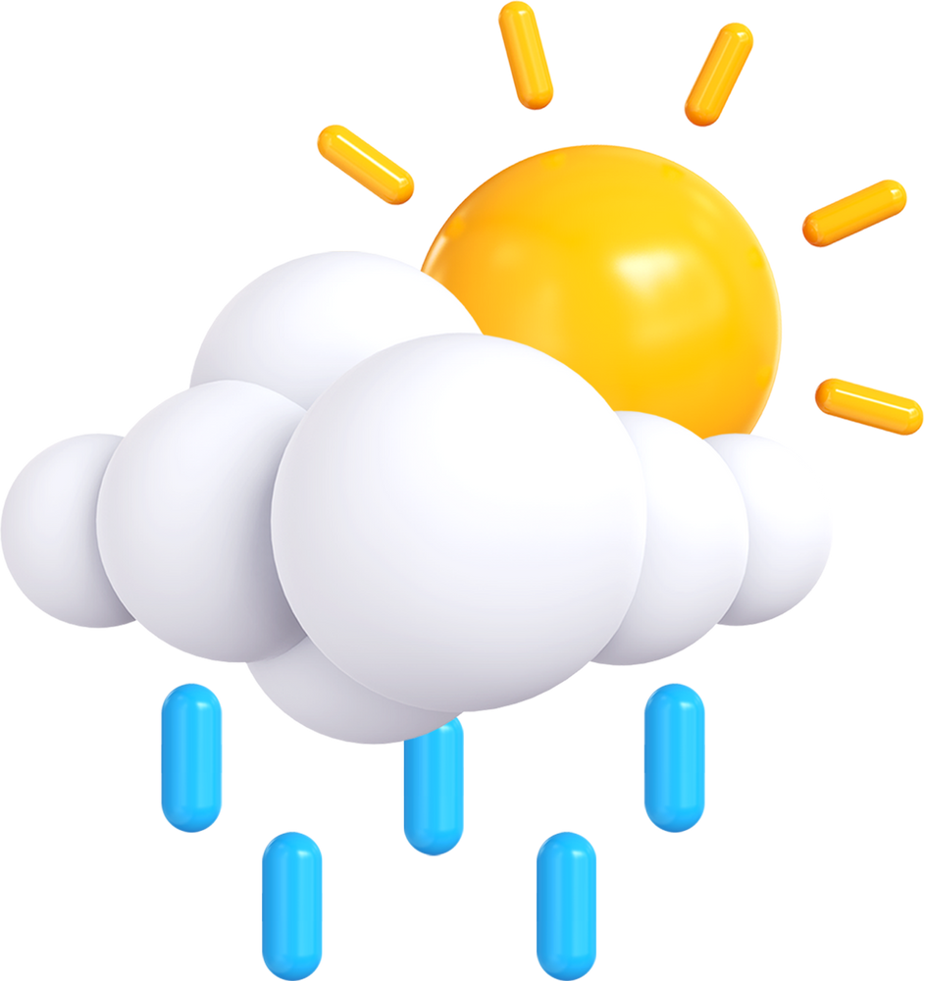
THANK YOU

